Slide 1
Change log
August 6th 2021
Updated Introduction slide to include reference for EKS public in the comments section.
Updated Benefits slide to to include reference for EKS in the comments section.
Updated ECR image scanning slide comment section.
Added slide to display a solution for automating image compliance through ECR image scanning.
Added ECR Public slide (concepts, security, public gallery).
Added ECR pricing slide with main concepts and free tier information.

Slide 2
Introduction to Amazon Elastic Container Registry
Containers Immersion Day: Module 2

Slide 3
AWS container services landscape
Management
Deployment, Scheduling, Scaling & Management of containerized applications
Amazon Elastic
Container Service
Amazon Elastic
Container Service for Kubernetes
Hosting
Where the containers run
Amazon EC2
AWS Fargate
Image Registry
Container Image Repository
Amazon Elastic
Container Registry
Notes:
SAY: You have understand a little more about containers and Docker than you did before we started the day.
SAY: In this next section, we’re going to talk about an essential tool in the toolbelt of all modern software engineering organizations Container Image Registries. (Section takes approximately 45 minutes)

Slide 4
What are container image registries?
”A container image registry is a service that stores container images, and is hosted either by a third-party or as a public/private registry such as Docker Hub, Quay, and so on [Amazon Elastic Container Registry].”
https://wiki.aquasec.com/display/containers/Container+Image+Registries
Notes:
Read this to the attendees

Slide 5
Amazon Elastic
Container Registry
Notes:
SAY: Amazon Elastic Container Registry (Amazon ECR) is a managed AWS container image registry service
SAY: Amazon ECR supports public and private container image repositories with resource-based permissions using AWS IAM so that specific users or Amazon EC2 instances can access repositories and images
SAY: Developers can use their preferred CLI to push, pull, and manage Docker images, Open Container Initiative (OCI) images, and OCI compatible artifacts.
YOU MIGHT WANT TO SAY: Other container registries include Docker Hub, Docker Registry Red Hat Quay. Container registries offer different types of functionality and it is important to consider what you need when evaluating the options. For example, integration with identity and access management solutions, image signing, image scanning, and pull rate limits.

Slide 6




The benefits of using Amazon ECR
Fully Managed
Secure
Highly Available
Simplified Workflow
Notes:
SAY: Let’s unpack Amazon ECR and discuss some of the benefits of using it for your next container deployment.
SAY: ECR is Fully managed
Amazon Elastic Container Registry eliminates the need to operate and scale the infrastructure required to power your container registry.
SAY: ECR is Secure
Amazon Elastic Container Registry transfers your container images over HTTPS and automatically encrypts your images at rest. You can configure policies to manage permissions and control access to your images using AWS Identity and Access Management (IAM) users and roles without having to manage credentials directly on your EC2 instances.
SAY: ECR is Highly available
Amazon Elastic Container Registry has a highly scalable, redundant, and durable architecture. Your container images are highly available and accessible, allowing you to reliably deploy new containers for your applications.
SAY: ECR provides a simplified workflow
Amazon Elastic Container Registry integrates with Amazon ECS/EKS and the Docker CLI, allowing you to simplify your development and production workflows. You can easily push your container images to Amazon ECR using the Docker CLI from your development machine, and Amazon ECS/EKS can pull them directly for production deployments.

Slide 7
Components of Amazon ECR
Notes:
SAY: Let’s now take a look at the different components of Amazon ECR

Slide 8

Amazon ECR Registries
https://205094881157.dkr.ecr.us-west-2.amazonaws.com
Amazon ECR
Notes:
SAY: An Amazon ECR registry is provided to each AWS account; you can create image repositories in your registry and store images in them.
SAY: Amazon ECR registries host your container images in a highly available and scalable architecture, allowing you to deploy containers reliably for your applications. You can use your registry to manage image repositories consisting of Docker and Open Container Initiative (OCI) images. Each AWS account is provided with a single (default) Amazon ECR registry.
SAY: By default, your account has read and write access to the repositories in your default registry. However, IAM users require permissions to make calls to the Amazon ECR APIs and to push or pull images from your repositories
SAY: Repositories can be controlled with both IAM user access policies and repository policies

Slide 9

Amazon ECR Repositories
https://205094881157.dkr.ecr.us-west-2.amazonaws.com
Amazon ECR
team-a/web-app
team-b/web-app
Notes:
SAY: Amazon Elastic Container Registry (Amazon ECR) provides API operations to create, monitor, and delete image repositories and set permissions that control who can access them. You can perform the same actions in the Repositories section of the Amazon ECR console. Amazon ECR also integrates with the Docker CLI allowing you to push and pull images from your development environments to your repositories.
SAY: By default, your account has read and write access to the repositories in your default registry. However, IAM users require permissions to make calls to the Amazon ECR APIs and to push or pull images from your repositories
SAY: Repositories can be controlled with both IAM user access policies and repository policies
Ref: https://docs.aws.amazon.com/AmazonECR/latest/userguide/Repositories.html#repository-concepts

Slide 10
Container Images
https://205094881157.dkr.ecr.us-west-2.amazonaws.com
Amazon ECR
team-a/web-app
team-b/web-app
My app image
OCI image OCI Artifacts
Notes:
SAY: Amazon Elastic Container Registry (Amazon ECR) stores Docker images, Open Container Initiative (OCI) images, and OCI compatible artifacts in repositories.
SAY: You can use the Docker CLI or your preferred client to push and pull images to and from your repositories.
SAY: OCI compatible artifacts include things like Helm charts
Ref: https://aws.amazon.com/blogs/containers/oci-artifact-support-in-amazon-ecr/

Slide 11
Container Images: Lifecycle policies
https://205094881157.dkr.ecr.us-west-2.amazonaws.com
My app image
:1
Amazon ECR
team-a/web-app
My app image
:<no tag>
My app image
My app image
:3
Notes:
SAY: Amazon ECR lifecycle policies enable you to specify the lifecycle management of images in a repository.
SAY: A lifecycle policy is a set of one or more rules, where each rule defines an action for Amazon ECR
SAY: The actions apply to images that contain tags prefixed with the given strings.
SAY: This allows the automation of cleaning up unused images, for example expiring images based on age or count.
SAY: You should expect that after creating a lifecycle policy the affected images are expired within 24 hours.
SAY: For example …. <CLICK>

Slide 12
Container Images: Lifecycle policies
https://205094881157.dkr.ecr.us-west-2.amazonaws.com
{
"rules": [
{
"rulePriority": 1,
"description": "Expire images older than 14 days",
"selection": {
"tagStatus": "untagged",
"countType": "sinceImagePushed",
"countUnit": "days",
"countNumber": 14
},
"action": {
"type": "expire"
}
}
]
}
My app image
:1
Amazon ECR
team-a/web-app
My app image
:<no tag>
My app image
My app image
:3
Notes:
SAY: … we might create a policy that expires (deletes) untagged images older than 14 days.

Slide 13
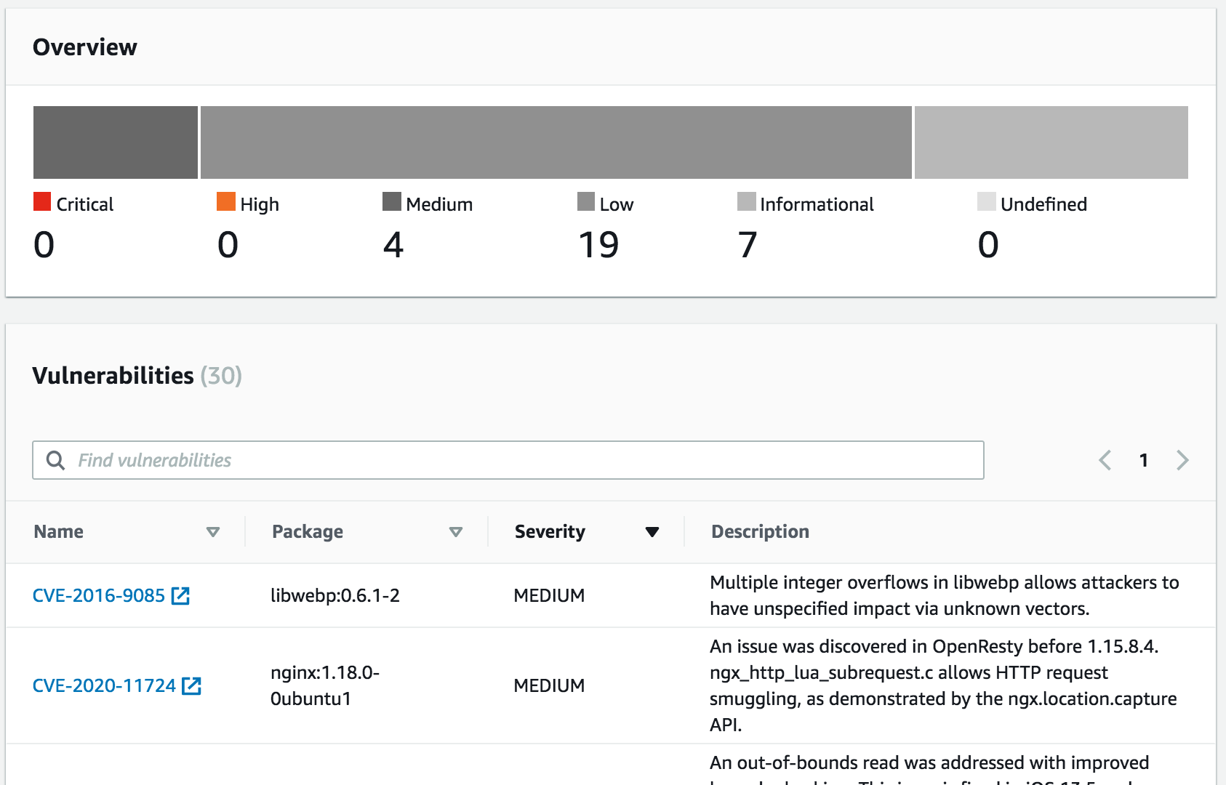

Container Images: Image scanning
https://205094881157.dkr.ecr.us-west-2.amazonaws.com
Amazon ECR
team-a/web-app
My app
image
Amazon EventBridge
Notes:
SAY: Amazon ECR image scanning helps in identifying software vulnerabilities in your container images. Amazon ECR uses the Common Vulnerabilities and Exposures (CVEs) database from the open source Clair project and provides you with a list of scan findings
SAY: You can manually scan container images stored in Amazon ECR, or you can configure your repositories to scan images when you push them to a repository. Each image may be scanned once per 24 hours, and it is available at no additional charge.
SAY: Amazon ECR sends an event to Amazon EventBridge (formerly called CloudWatch Events) when an image scan is completed. From there, you can drive workflows and automations such as deploying or sending notifications.

Slide 14








Container Images: Automate compliance with image scanning
AWS Cloud
Image blocked (Critical or high CVE)
ECR Permission Policy
AWS Lambda
Security Hub
Custom action
Image CVE
findings
Image push
Container Image
Amazon ECR
Amazon CloudWatch
AWS Lambda
AWS Security Hub
Medium or low CVE
Amazon EKS
Amazon ECS
Notes:
You can automate image scanning, and automatically take action to prevent images with critical or high CVEs from being deployed to your cluster. This gives developers the opportunity to take proper remediation actions while ensuring image compliance.
Reference: https://aws.amazon.com/blogs/containers/automating-image-compliance-for-amazon-eks-using-amazon-elastic-container-registry-and-aws-security-hub/

Slide 15
Security in Amazon Elastic Container Registry
https://205094881157.dkr.ecr.us-west-2.amazonaws.com
{
"Version": "2012-10-17",
"Statement": [
{
"Effect": "Allow",
"Action": [
"ecr:GetAuthorizationToken",
"ecr:BatchCheckLayerAvailability",
"ecr:GetDownloadUrlForLayer",
"ecr:GetRepositoryPolicy",
"ecr:DescribeRepositories",
"ecr:ListImages",
"ecr:DescribeImages",
"ecr:BatchGetImage",
"ecr:GetLifecyclePolicy",
"ecr:GetLifecyclePolicyPreview",
"ecr:ListTagsForResource",
"ecr:DescribeImageScanFindings"
],
"Resource": "*"
}
]
}
Amazon ECR
team-a/web-app
Team B
Notes:
SAY: Identity and Access Management (IAM) administrators control who can be authenticated (signed in) and authorized (have permissions) to use Amazon ECR resources.
SAY: IAM is an AWS service that you can use with no additional charge.
SAY: In this example we’re using an Amazon ECR Identity-Based policy to grant the members of team B rights to read the images in the team-a/web-app repository. This policy would be attached to the team B members directly, or via a role / group.

Slide 16
Security in Amazon Elastic Container Registry
https://205094881157.dkr.ecr.us-west-2.amazonaws.com
{
"Version": "2008-10-17",
"Statement": [
{
"Sid": "AllowPushPull",
"Effect": "Allow",
"Principal": {
"AWS": [
"arn:aws:iam::account-id:user/push-pull-user-1",
"arn:aws:iam::account-id:user/push-pull-user-2"
]
},
"Action": [
"ecr:GetDownloadUrlForLayer",
"ecr:BatchGetImage",
"ecr:BatchCheckLayerAvailability",
"ecr:PutImage",
"ecr:InitiateLayerUpload",
"ecr:UploadLayerPart",
"ecr:CompleteLayerUpload"
]
}
]
}
Amazon ECR
team-b/web-app
Another AWS Account
Team C
Notes:
SAY: In this example we’re using Amazon ECR Resource-based policies to, for example, grant usage permission to other accounts on a per-resource basis. You can also use a resource-based policy to allow an AWS service to access your Amazon ECR repositories.
SAY: I’m now going to run a quick demonstration to show you how easy it is to create an Amazon ECR repository within my accounts default registry. I will also show you how to quickly build an OCI compliance container image using the Docker CLI and use the docker push command to push the image in to the newly created repository.

Slide 17

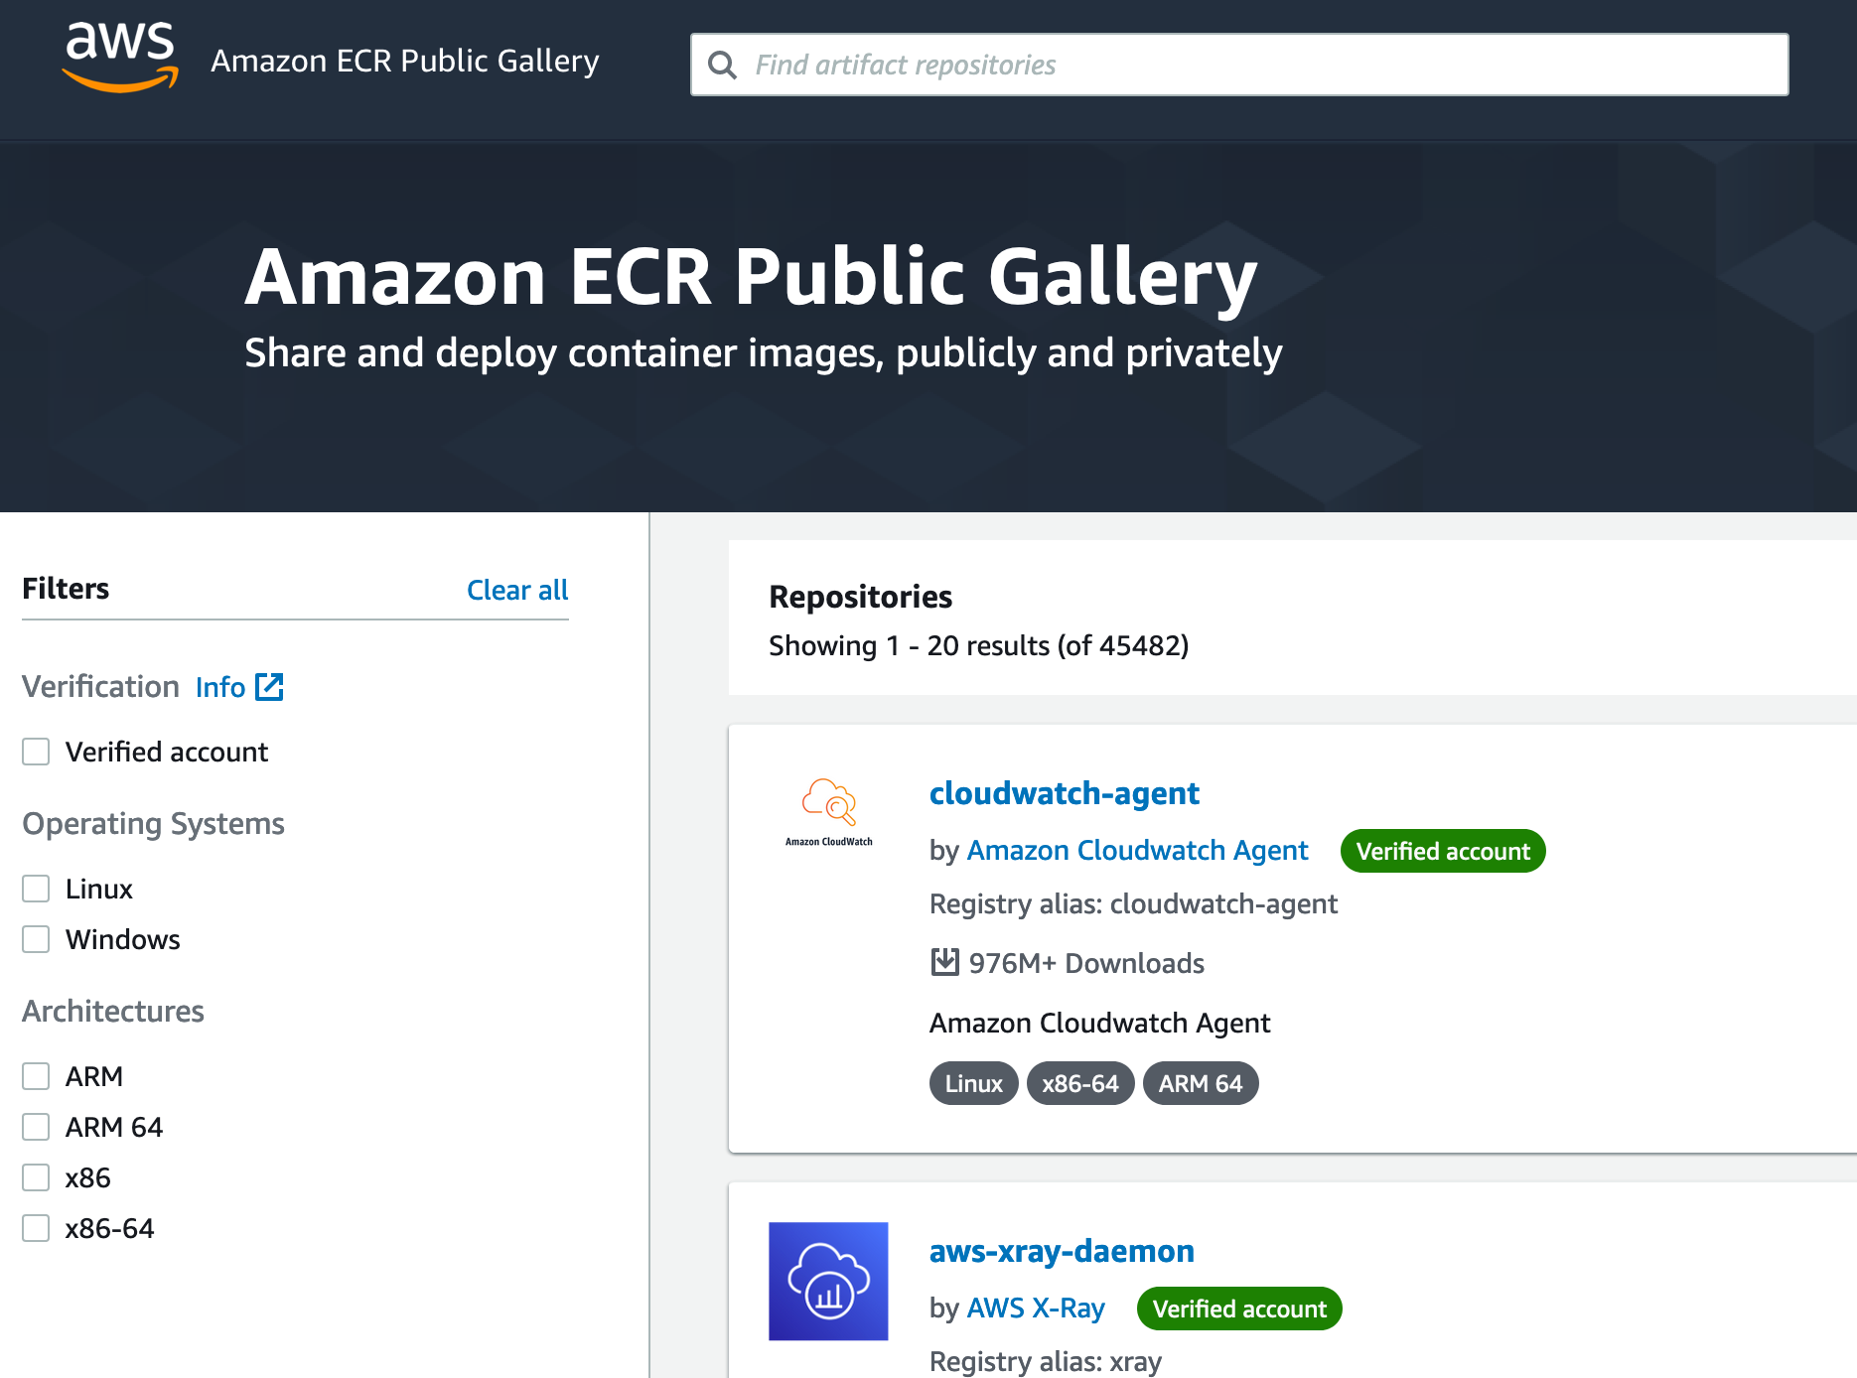
Amazon ECR Public
registry-alias/web-app
https://gallery.ecr.aws
{
"Version": "2008-10-17",
"Statement": [
{
”Sid": ”ECR Public Repository Policy"
"Effect": "Allow",
”Principal": {
”AWS”: "arn:aws:iam::account-id:user/username”
}
"Action": [
"ecr-public:DescribeImages ",
"ecr-public:DescribeRepositories "
]
}
]
}
Notes:
Security: Use IAM and Repository policies to control access and who can push to your public repositories.
Pricing: ECR offers 50GB-month of always free storage, and you don’t pay for pulls done to your public images (Account publishing only pays for storage)
ECR Public Gallery: Verified accounts, free for anyone to browse (don’t need an AWS account to search or pull a public image).
Public Registry: Your public repositories will be available in the Amazon ECR Public Gallery under your registry alias.
Highly Available: ECR Public automatically replicates container images across two AWS Regions, and caches image layers in Amazon CloudFront to improve pull performance for a global audience.

Slide 18
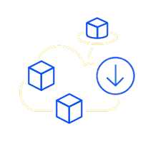


Amazon ECR pricing
You only pay for the amount of data you store, and data transferred to the internet.
Storage is $0.10 per GB-month beyond free tier.
50 GB-month of always-free storage for your public repositories, and free tier includes 500 MB-month of storage for one year for your private repositories.
You can transfer 500 GB-month of data to the internet for free from a public repository anonymously, and 5 TB-month with an AWS account.
Notes:
You only pay for the amount of data stored and data transfers (when applicable). Beyond free tier limits storage is $0.10 per GB-month for data stored in private or public repositories.
You can transfer 500 GB of data to the internet for free from a public repository each month anonymously (without using an AWS account.),and 5 TB of data to the internet for free from a public repository each month when authenticated (with an AWS account).
50GB-month of always free-storage (for public and private repositories), and free tier includes 500 MB-month.

Slide 19
Demo of creating an Amazon ECR repository
Notes:
[RUN] a demo of creating an Amazon ECR repository using the management console. Pushing an image and seeing image scanning kicking-in.

Slide 20
Questions?
Introduction to Amazon ECR
Notes:
SAY: That raps up module two. In the next lab you’re going to build on your new found container building skills and help the team over at mythical mysfits package up their monolithic application and push it to an Amazon ECR repository.
Any questions?

Slide 21

Containers Immersion Day: Hands-on labs
Notes:
SAY: Time to get started with our first hands-on labs. We’re going to start by getting our environment setup, then we’re going to take a monolithic application and package it up in to a container using Docker. From there, you will be pushing the container image in to an Amazon ECR repository.

Slide 22
Welcome to Mythical Mysfits
Our mission: Ethical, mythical creature care.
Our priority: Find homes for the abandoned, and often misunderstood, mythical creatures in our community.
Help us find their forever homes!
Your mission: Modernize and innovate on the Mythical stack.
Lab 1: Containerize the monolithic application.
Lab 2: Deploy containers using AWS Fargate.
Lab 3: Scale and lay the foundation for microservices with an AWS Application Load Balancer.
Lab 4: Our developers completed Project Cuddle which adds a “like” feature to the application. Since we want to move to a microservices design, help us break this functionality from the monolith and deploy it with AWS Fargate as its own containerized microservice.
Notes:
SAY: For all of our hands-on work today, you will all need to take on a new persona. The persona of a newly minted engineer at Mythical Mysfits. The latest and greatest start-up from here in <CHOOSE_YOUR_CITY>
SAY: The mission of Mythical Mysfits is to find homes for the abandoned, and often misunderstood, mythical creatures in our community.
SAY: Your mission today is to help the company modernize and innovate on the mythical stack.

Slide 23








Lab 1: Build and test monolith container image
AWS Cloud
VPC
Amazon S3
Users
Public subnet
Private subnet
Monolith
Amazon CloudWatch
AWS Cloud9
Amazon ECR
Amazon DynamoDB
Notes:
SAY: In the first lab, you’re going to take the first step in modernizing the Mythical stack, by containerizing the monolith application that is currently used for all the things. From there, you’re going to push that image image in to an image repository hosted in Amazon ECR.

